Slide 1
SOFTWARE PARADIGMS
MEMOONA SAMI
Disclaimer: The contents in this presentation have been taken from multiple sources available at the internet including books, motes, reports, websites and presentations.

Slide 2
Disclaimer
The material used in this presentation i.e., pictures/graphs/text, etc. is solely intended for educational/teaching purpose, offered free of cost to the students for use under special circumstances of Online Education due to COVID-19 Lockdown situation and may include copyrighted material - the use of which may not have been specifically authorized by Copyright Owners. It’s application constitutes Fair Use of any such copyrighted material as provided in globally accepted law of many countries. The contents of presentations are intended only for the attendees of the class being conducted by the presenter.

Slide 3
Software Paradigms
Software paradigms refer to the methods and steps, which are taken while designing the software. There are many methods proposed and are in work today, but we need to see where in the software engineering these paradigms stand. These can be combined into various categories, though each of them is contained in one another:

Slide 4
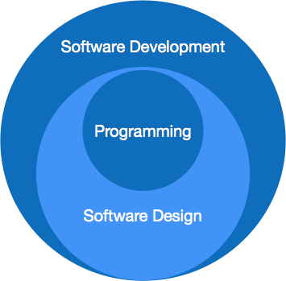
Software Paradigms

Slide 5
Software Paradigms
Programming paradigm is a subset of Software design paradigm which is further a subset of Software development paradigm.

Slide 6
Software Development Paradigm
Software Development Paradigm
This Paradigm is known as software engineering paradigms where all the engineering concepts pertaining to the development of software are applied. It includes various researches and requirement gathering which helps the software product to build. It consists of –
Requirement gathering
Software design
Programming

Slide 7
Software Design Paradigm
Software Design Paradigm
This paradigm is a part of Software Development and includes –
Design
Maintenance
Programming

Slide 8
PROGRAMMING Paradigm
This paradigm is related closely to programming aspect of software development. This includes –
Coding
Testing
Integration

Slide 9
Why is Software Engineering required?
Software Engineering is required due to the following reasons:
To manage Large software
For more Scalability
Cost Management
To manage the dynamic nature of software
For better quality Management

Slide 10
Need of Software Engineering
The necessity of software engineering appears because of a higher rate of progress in user requirements and the environment on which the program is working.
Huge Programming: It is simpler to manufacture a wall than to a house or building, similarly, as the measure of programming become extensive engineering has to step to give it a scientific process.
Adaptability: If the software procedure were not based on scientific and engineering ideas, it would be simpler to re-create new software than to scale an existing one.
Cost: As the hardware industry has demonstrated its skills and huge manufacturing has let down the cost of computer and electronic hardware. But the cost of programming remains high if the proper process is not adapted.
Dynamic Nature: The continually growing and adapting nature of programming hugely depends upon the environment in which the client works. If the quality of the software is continually changing, new upgrades need to be done in the existing one.
Quality Management: Better procedure of software development provides a better and quality software product.

Slide 11
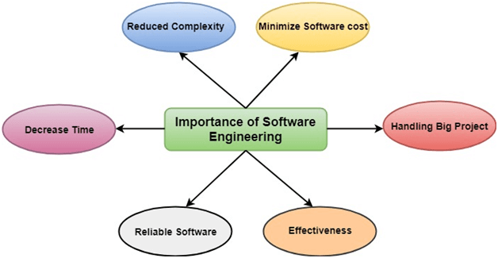
Importance of Software Engineering

Slide 12
The importance of Software engineering is as follows:
Reduces complexity: Big software is always complicated and challenging to progress. Software engineering divides big problems into various small issues. And then start solving each small issue one by one.
To minimize software cost: Software needs a lot of hardwork and software engineers are highly paid experts. But in software engineering, programmers project everything and decrease all those things that are not needed.

Slide 13
The importance of Software engineering is as follows:
To decrease time: Anything that is not made according to the project always wastes time. This is a very time-consuming procedure, and if it is not well handled, then this can take a lot of time.
Handling big projects: Big projects are not done in a couple of days, and they need lots of patience, planning, and management. And to invest six and seven months of any company, it requires heaps of planning, direction, testing, and maintenance.

Slide 14
The importance of Software engineering is as follows:
Reliable software: Software should be secure, means if you have delivered the software, then it should work for at least its given time or subscription. And if any bugs come in the software, the company is responsible for solving all these bugs
Effectiveness: Effectiveness comes if anything has made according to the standards. Software standards are the big target of companies to make it more effective.

Slide 15
Characteristics of a good software engineer
The features that good software engineers should possess are as follows:
Exposure to systematic methods, i.e., familiarity with software engineering principles.
Good technical knowledge of the project range (Domain knowledge).
Good programming abilities.

Slide 16
Good communication skills. These skills comprise of oral, written, and interpersonal skills.
High motivation.
Sound knowledge of fundamentals of computer science.
Intelligence.
Ability to work in a team
Discipline, etc.

